Slide 1
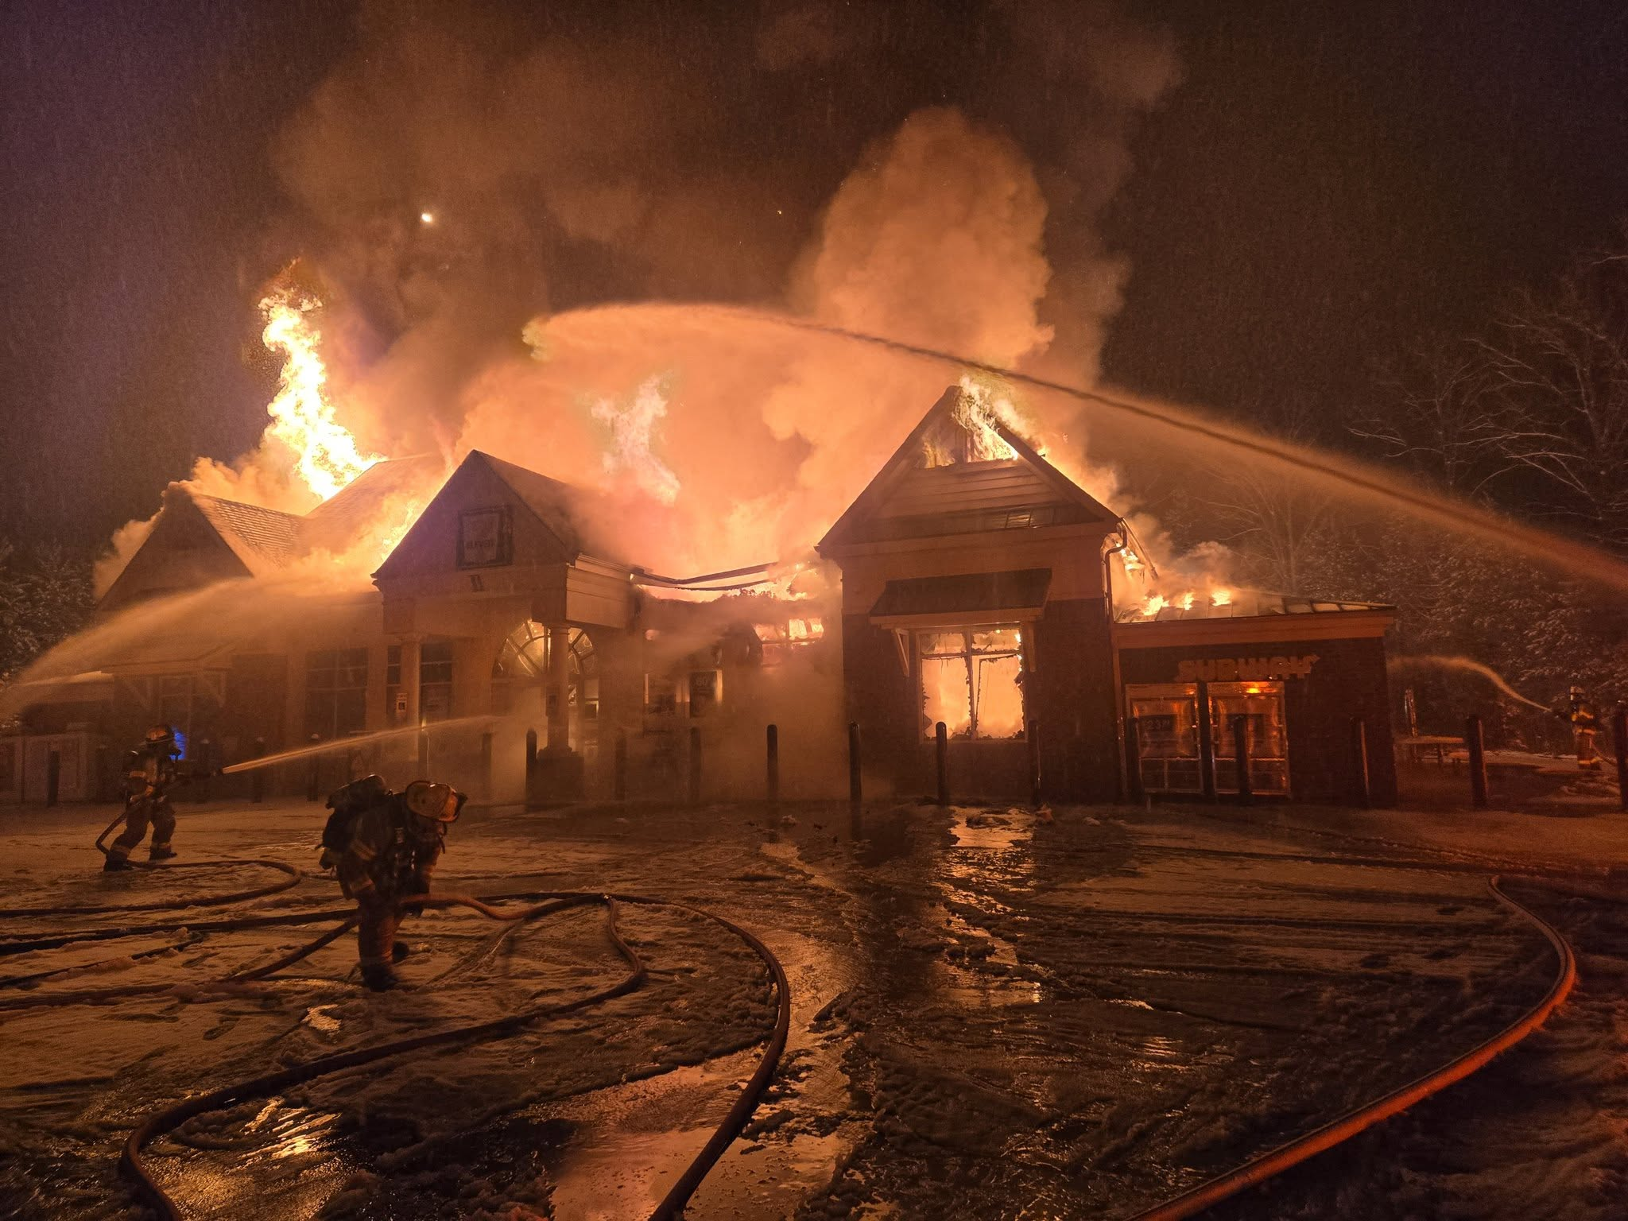

Professional Society
Of
Safety Engineers
March 24, 2026

Slide 2
Gerald E. Pruden
Director

Slide 3
Gerald E. Pruden
Small Business Owner/Entrepreneur
Lawn Care Business
Residential Laundry Service
3 Star Restaurant
Logistical Delivery Company
Residential Cleaning Service
Luxury Transportation Company
Financial and Investment Company
Retired From
Chesterfield Fire and EMS
44 ½ Years
October 1, 2025

Slide 4
Mission:
Dedicated to the advancement
of burn care, research,
prevention, education,
and proper treatment of burns.
Mission:
Dedicated to the advancement
of burn care, research,
prevention, education,
and proper treatment of burns.

Slide 5










Richmond Metro Area Firefighters

Slide 6

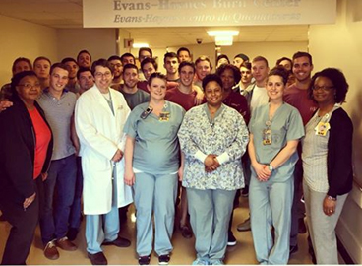

Slide 7
Inspired by her VCU Health care team, burn survivor makes her nursing graduation ceremony a full-circle moment by VIRGINIA COMMONWEALTH UNIVERSITY - VCU News - Visual Stories

Slide 8


Major Sponsor
$786,000.00

Slide 9
Notes:
The Burn Center has a state-of-the-art procedure room for the management of burn wounds. Designed to minimize the spread of wound infections, hydrotherapy bathes patients, cleans wound surfaces and allows the Burn Team to monitor progression of the healing process. The procedure room also is a designated area for our pediatric population; initiating wound care in the procedure room allows their room to be a safe place. The procedure room has the ability to be used as an operating room with lighting and ventilation to accommodate any procedures

Slide 12

Kendra Yates
Story

Slide 13


